Slide 1
Team Data Science Process with Microsoft Azure
Fernando Mejía
OSS Architect
Global Black Belt Team
Notes:
https://medium.com/adventures-in-consumer-technology/five-steps-to-approaching-machine-learning-for-your-business-af25e91743f2

Slide 2
Session objectives and takeaways
At the end of this session, you should be
better able to…
Use a proven structure to create a successful Advanced Analytics Engagement
Understand the primary success points and how to deliver incremental wins during the project
Understand a tools-selection mechanism to select the right Data Science technologies for your project

Slide 3

Class
Self-Study
Projects
Notes:
There’s a lot of information here. You’ll get hands-on experience in class, with a chance to ask an instructor any questions you might have. However, this forms only a small part of learning so many technologies and processes.
The next largest section of your learning is to read each and every reference in the student handouts. Many point to books, websites and entire courses you can take in each topic. You won’t be expected to learn all of them at once – it’s more common to pull out the sections you need when you do a project, and learn about that technology before you implement it.
You’ll learn the most by actually creating and implementing solutions for your customers. You will do a quick design during this course, but that is a small sample of working with the technologies in a hands-on fashion. The good news is that you’ll find everything you need to be successful in this course and these materials.

Slide 4
What we’ll cover
Data Science is the latest tool in an organization’s analytics arsenal. Many leaders are interested in what Advanced Analytics and Data Science can do to help them, and after they investigate the possibilities they engage with a team to start a project. The initial thought is that a Data Science project is similar to any other technology project. But Data Science, unlike other IT efforts, has specific elements that are exploratory and experiment-based, which many organizations are unfamiliar with. So how do you explain the project, implement it, and keep it on track? We’ll learn the start-to-finish steps and process to engage the stakeholders on the project, how to lay out the process and timeline, define the goals, and deliver on the project. You’ll learn the pitfalls and how to avoid them, how to move the project along, and the “little wins” that will keep the customer engaged.

Slide 5

The Data Science Difference

Slide 6
Data Analytics Landscape
Data Acquisition, Storage, and Processing
Collection hygiene
Intelligent storage
Data engines (RDBMS, NoSQL)
Reporting
Query languages
Tabular results
Graphical presentation
Business Intelligence
Multi-dimensional queries
Historical aggregations
Exploration and question generation
Cognitive Intelligence
Adaptive
Interactive
Iterative and Stateful
Contextual

Slide 7
The Data Science Project Formula
Question + Data + Analysis = Answer
…which leads to a Decision/Action
“What will you do when you know the answer?”

Slide 8
The Team Data Science Process
Business Understanding
Define Objectives
Identify Data Sources
Data Acquisition and Understanding
Ingest Data
Explore Data
Modeling
Feature Selection
Create and Train Model
Deployment
Customer Acceptance
Operationalize
Testing and Validation
Update Data
Handoff
Re-train and re-score
http://aka.ms/tdsp
Notes:
It also references the Microsoft Business Analytics and AI process - https://docs.microsoft.com/en-us/azure/machine-learning/team-data-science-process/overview
A complete process diagram is here - https://azure.microsoft.com/en-us/documentation/learning-paths/data-science-process/
Some walk-throughs of the various services - https://azure.microsoft.com/en-us/documentation/articles/data-science-process-walkthroughs/
An integrated process and toolset allows for a more close-to-intent deployment
Iterations are required to close in on the solution – but are harder to manage and monitor – We’ll cover DevOps for Data Science in this course to assist.
Data Science Blog - https://buckwoody.wordpress.com/

Slide 9
The Azure Platform for Analytics and AI
Big Data
Intelligence and Advanced Analytics
Information Management
Solutions
Visualization
Data Catalog
Data Factory
Event Hubs
Data Lake
SQL Data Warehouse
Cosmos DB
Cortana, Bot Service, Cognitive Framework
HDInsight
Data Lake
Azure Storage
Stream Analytics
Analysis Services
Power BI
R
Templates and Gallery
Azure Machine Learning Services
http://aka.ms/cisc
Notes:
Azure Data Catalog - http://azure.microsoft.com/en-us/services/data-catalog (Doc It)
Azure Data Factory - http://azure.microsoft.com/en-us/services/data-factory/ (Move It)
Azure Event Hubs - http://azure.microsoft.com/en-us/services/event-hubs/ (Bring It)
Platform and Storage - Microsoft Azure – https://azure.microsoft.com/ Storage - https://docs.microsoft.com/en-us/azure/storage/ (Host It)
Azure Data Lake - https://azure.microsoft.com/en-us/solutions/data-lake/ (Store It)
Azure SQL Data Warehouse - http://azure.microsoft.com/en-us/services/sql-data-warehouse/ (Relate It)
Azure Cosmos DB - https://docs.microsoft.com/en-us/azure/cosmos-db/introduction
Cortana - https://developer.microsoft.com/en-us/Cortana and https://blogs.windows.com/buildingapps/2017/05/10/cortana-skills-kit-empowers-developers-build-intelligent-experiences-millions-users/#AXrmKPb74ugDDmG7.97 and https://www.microsoft.com/en-us/windows/cortana/cortana-skills/ (Say It)
Cognitive Services - https://www.microsoft.com/cognitive-services
Bot Framework - https://dev.botframework.com/
Azure Machine Learning - https://docs.microsoft.com/en-us/azure/machine-learning/preview/ (Learn It)
Azure HDInsight - http://azure.microsoft.com/en-us/services/hdinsight/ (Scale It)
Azure Stream Analytics - http://azure.microsoft.com/en-us/services/stream-analytics/ (Stream It)
Analysis Services - https://docs.microsoft.com/en-us/azure/analysis-services/analysis-services-overview
Power BI - https://powerbi.microsoft.com/ (See It)
All of the components within the suite - https://www.microsoft.com/en-us/cloud-platform/what-is-cortana-intelligence
Templates - https://gallery.cortanaintelligence.com/browse?orderby=freshness%20desc&skip=0&categories=%5B%2210%22%5D and https://caqs.azure.net/#gallery

Slide 10
Cortana Intelligence Suite | Overview
Information Management
Big Data Stores
Machine Learning and Analytics
Intelligence
Real-time Data
Data Factory
Data Lake Store
Machine Learning
Cognitive Services
Dashboards and Visualization
Data Catalog
SQL Data
Warehouse
Data Lake Analytics
Bot Framework
HDInsight
(Hadoop and Spark)
Event Hubs
Cortana
Stream Analytics
Historical Data
Dashboards & Visualizations
Personalized Offers
Power BI
Data
Intelligence
Action
Notes:
Cortana Intelligence Suite delivers an end-to-end platform with integrated and comprehensive set of tools and services to help you build intelligent applications that let you easily take advantage of Advanced Intelligence.
First Cortana Intelligence Suite provides services to bring data in, so that you can analyze it. It provides information management capabilities like Azure Data Factory so that you can pull data from any source (relational DB like SQL or non-relational ones like your Hadoop cluster) in an automated and scheduled way, while performing the necessary data transforms (like setting certain data columns as dates vs. currency etc.). Think ETL (Extract, Transform, Load) in the cloud. Event hub does the same for IoT type ingestion of data that streams in from lots of end points.
The data brought in then can be persisted in flexible big data storage services like Data Lake and Azure SQL DW.
You can then use a wide range of analytics services from Azure ML to Azure HDInsight to Azure Stream Analytics to analyze the data that are stored in the big data storage. This means you can create analytics services and models specific to your business need (say real time demand forecasting).
The resultant analytics services and models created by taking these steps can then be surfaced as interactive dashboards and visualizations via Power BI
These same analytics services and models created can also be integrated into various different UI (web apps or mobile apps or rich client apps) as well as via integrations with Cortana, so end users can naturally interact with them via speech etc., and so that end users can get proactively be notified by Cortana if the analytics model finds a new anomaly (unusual growth in certain product purchases- in the case of real time demand forecasting example given above) or whatever deserves the attention of the business users.

Slide 11

Business Case
Wide World Importers is a company that imports and distributes products in multiple countries around the globe.
With several thousand employees, Information Technology is at the heart of our business operations, and has a significant cost.
Since we handle materials in multiple countries, we have a lot of private data, financial information, and other targets which have a high security profile. We are concerned with both external and internal attacks. In addition, many of our employees work in remote locations, some on ships and other challenging environments.
All of our IT systems have been modernized, and we’re taking in a significant amount of semi-structured data from computing devices – most of it real-time. After talking with our IT leadership, we need a way to determine anomalies within the data streams we get, and have a way to observe the anomalies in a dashboard so that we can respond to outages, threats, and changes quickly.
Notes:
More about Wide World Importers: https://docs.microsoft.com/en-us/sql/sample/world-wide-importers/overview
Anomaly Detection: https://gallery.cortanaintelligence.com/Solution/Anomaly-Detection-in-Real-time-Data-Streams

Slide 12

Design Statements
Wide World Importers is a company that imports and distributes products in multiple countries around the globe.
With several thousand employees, Information Technology is at the heart of our business operations, and has a significant cost.
Since we handle materials in multiple countries, we have a lot of private data, financial information, and other targets which have a high security profile. We are concerned with both external and internal attacks. In addition, many of our employees work in remote locations, some on ships and other challenging environments.
All of our IT systems have been modernized, and we’re taking in a significant amount of semi-structured data from computing devices – most of it real-time. After talking with our IT leadership, we need a way to determine anomalies within the data streams we get, and have a way to observe the anomalies in a dashboard so that we can respond to outages, threats, and changes quickly.
Notes:
More about Wide World Importers: https://docs.microsoft.com/en-us/sql/sample/world-wide-importers/overview
Anomaly Detection: https://gallery.cortanaintelligence.com/Solution/Anomaly-Detection-in-Real-time-Data-Streams

Slide 13
Decision Matrix
Decision | Technology | Elements | Rationale
Large amounts of semi-structured data | Azure Tables | Scale, KVP, Multi-access | Can be used by multiple technologies or queried
Fast, multiple sources of data | Event Hubs, Stream Analytics | Speed, complex processing | Fast Ingestion of massive datasets
Anomaly detection | Azure ML | API-Driven detection | Built-in algorithms, multi-dev
Reporting | SQL DB, Power BI | Ease of reporting, data visualization | Standard queries, action-based visualizations
System monitoring and management | Azure Data Factory, Application Insights | Actionable system metrics | OOB orchestration and reporting
Notes:
Another approach on decision matrices: http://www.businessnewsdaily.com/6146-decision-matrix.html

Slide 14
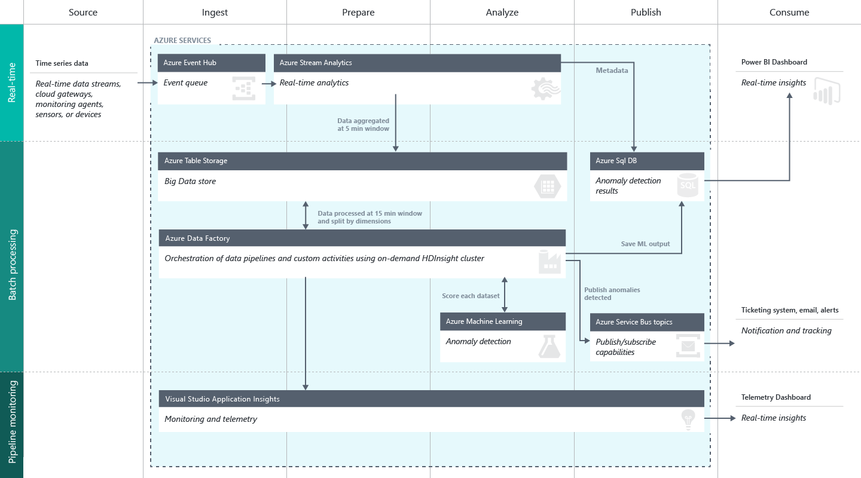
Create a Solution Workflow
Notes:
Full description is here: https://github.com/Azure/itanomalyinsights-cortana-intelligence-preconfigured-solution/blob/master/Docs/IT%20Anomaly%20Insights%20Post%20Deployment%20Instructions.md
Create your own Solution Templates: https://start.cortanaintelligence.com/CustomSolutions
More solution tutorials: https://gallery.cortanaintelligence.com/browse?categories=%5B%227%22%5D&skip=0&orderby=trending%20desc&tags=%5B%22Solution%22%5D

Slide 15
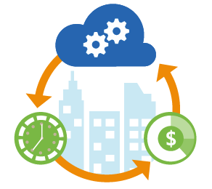
Azure DevOps for Advanced Analytics
Deployment
Tooling
Facilities and Regions
Resource Grouping
Safety
Auditing and Reporting
Troubleshooting
Service creation and setup
Security
Cost management
Monitoring and Management
Development
Automation
Options
Optimization
Regulatory requirements
Dev/Test/Production
Groups for monitoring and billing
Redundancy
Recovery strategies
Outage fallbacks
Issue identification
Resolution call tree
Telemetry data collection and storage
Report distribution
Automated alerts
Networking and Hybrid
Support
Scheduling
Migration
Notes:
Deployment
Service Creation and Setup - https://azure.microsoft.com/en-us/offers/ms-azr-0003p/
Authentication and Access - https://docs.microsoft.com/en-us/azure/active-directory/connect/active-directory-aadconnect
Security best practices - https://docs.microsoft.com/en-us/azure/active-directory/role-based-access-control-configure
Cost Management (Pricing) - https://azure.microsoft.com/en-us/pricing/
Migrations - https://msdn.microsoft.com/en-us/library/dn727097.aspx
Tools
The Azure Portal - https://docs.microsoft.com/en-us/azure/azure-portal-overview
PowerShell - https://docs.microsoft.com/en-us/powershell/azure/overview?view=azurermps-3.8.0
CLI - https://docs.microsoft.com/en-us/cli/azure/install-azure-cli
Others - Visual Studio, System Center, Jenkins, chef
Azure Automation - https://azure.microsoft.com/en-us/services/automation/
Facilities and Regions
Locations - https://azure.microsoft.com/en-us/regions/
Azure Trust Center - https://azure.microsoft.com/en-us/support/trust-center/
Resource Grouping
Resource Groups - https://docs.microsoft.com/en-us/azure/azure-resource-manager/resource-group-overview
Using the ARM model - https://docs.microsoft.com/en-us/azure/azure-resource-manager/resource-group-template-deploy-portal
Safety - https://docs.microsoft.com/en-us/azure/storage/storage-redundancy
Auditing - https://msdn.microsoft.com/en-us/library/mt662411.aspx?f=255&MSPPError=-2147217396
Troubleshooting and Support - https://azure.microsoft.com/en-us/blog/understanding-azure-troubleshooting-and-support/
Special considerations for Advanced Analytics:
Account management
Storage and redundancy
Privacy and data protection
Scheduling and Pipelined workflows
Networking - https://www.simple-talk.com/cloud/cloud-data/azure-networking-sql-server-dbas/
Optimization
Security
Advanced Analytics Services awareness – data transfer, storage and processing
Dependencies and interactions
Full tutorial: https://github.com/Azure/DevOps-For-AI-Apps/blob/master/Tutorial.md

Slide 16

Success Factors for the Data Science Project

Slide 17
Success Factor: The Question
Question + Data + Analysis = Answer
Specific
Measurable
Unanimous
Actionable
Baselined
From Business Question to Data Science Question:
When should we service this machine so that it doesn’t break?
What is the probability that this machine will fail at a given time?
Notes:
The five questions data science can answer - https://docs.microsoft.com/en-us/azure/machine-learning/machine-learning-data-science-for-beginners-the-5-questions-data-science-answers
The question you can answer with data - https://docs.microsoft.com/en-us/azure/machine-learning/machine-learning-data-science-for-beginners-ask-a-question-you-can-answer-with-data
Copy other people’s work to do data science - https://docs.microsoft.com/en-us/azure/machine-learning/machine-learning-data-science-for-beginners-copy-other-peoples-work-to-do-data-science

Slide 18
Success Factor: The Data
Question + Data + Analysis = Answer
Sufficient
Reliable
Accessible
Related
Notes:
Is your data ready for data science - https://docs.microsoft.com/en-us/azure/machine-learning/machine-learning-data-science-for-beginners-is-your-data-ready-for-data-science
Correlation does not equal Causation - http://www.tylervigen.com/spurious-correlations

Slide 19
Success Factor: The Analysis
Question + Data + Analysis = Answer
Practical
Applicable
Computable
Verified
Get here as quickly as possible
Notes:
Predict an answer with a simple model - https://docs.microsoft.com/en-us/azure/machine-learning/machine-learning-data-science-for-beginners-predict-an-answer-with-a-simple-model

Slide 20
Success Factor: The Answer
Question + Data + Analysis = Answer
Real
Usable
Impactful
Valuable (Cost/Benefit)
Assigned
“What will you do when you know the answer?”
Notes:
Cost/Benefit Analysis: https://www.mindtools.com/pages/article/newTED_08.htm

Slide 21
Azure Storage for Advanced Analytics
Notes:
Data Storage Options (Building Real-World Cloud Apps with Azure): https://www.asp.net/aspnet/overview/developing-apps-with-windows-azure/building-real-world-cloud-apps-with-windows-azure/data-storage-options
Options: https://blogs.msdn.microsoft.com/uk_faculty_connection/2017/02/24/big-data-and-azure/

Slide 22
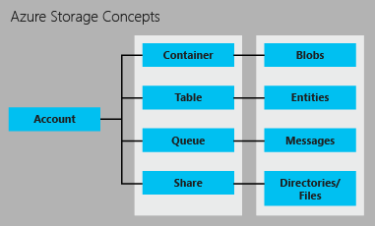
Storage Architecture
Azure Account
Notes:
A quick Overview: https://channel9.msdn.com/Blogs/Windows-Azure/Azure-Storage-5-Minute-Overview
More on Storage: https://azure.microsoft.com/en-us/documentation/articles/storage-introduction/

Slide 23
Storage Scenarios
Unstructured data such as media files, logs, binary data, backups
Metadata (e.g. user info), in key-value format, fast and easy to query
Messaging between components of your application
Shared file systems option – when your application is already built to use a SMB protocol
{‘name’: Sue,
‘role’: 'admin’,
‘status’: ‘active’,
‘location’: ‘WA’
Blob
Table
Queue
File
Notes:
Locations and Redundancy Overview: https://azure.microsoft.com/en-us/documentation/articles/storage-introduction/
Affects on Scalability and Performance Targets: https://azure.microsoft.com/en-us/documentation/articles/storage-scalability-targets/
Pricing Details: https://azure.microsoft.com/en-us/pricing/details/storage/

Slide 24

Redundancy and Location
LRS: 3 Copies, 1 Datacenter
GRS: 6 Copies, 2 Datacenters
ZRS: 3 Copies, 2-3 Datacenters
Notes:
Redundancy and location information: https://docs.microsoft.com/en-us/azure/storage/storage-redundancy

Slide 25
Creating and Managing Azure Storage
Azure Portal
Azure PowerShell
Azure Command Line Interface (CLI)
Service Management REST API
Azure Storage Resource Provider REST API
Notes:
Azure Portal - https://portal.azure.com/
Azure PowerShell - https://azure.microsoft.com/en-us/documentation/articles/storage-powershell-guide-full/
AZCOPY - https://azure.microsoft.com/en-us/documentation/articles/storage-use-azcopy/
Azure CLI - https://azure.microsoft.com/en-us/documentation/articles/storage-azure-cli/
Service management REST API - http://msdn.microsoft.com/library/azure/ee460799.aspx
Azure Storage Resource Provider REST API - https://msdn.microsoft.com/library/azure/mt163683.aspx

Slide 26



Lab:
Copy and view data on your storage account using AZCOPY
Notes:
Open the Azure Portal, create a Blob Storage Account in the region closest to your DVSM – note the name and access keys in NOTEPAD.EXE
From your DSVM, or if you installed the AZCOPY tool locally, open a command prompt. (Note: If you loaded AZCOPY locally, you will need to update your PATH system variable so that you can follow these instructions)
Navigate to this page: https://azure.microsoft.com/en-us/documentation/articles/storage-use-azcopy/
Locate the section marked “Blob: Upload - Upload single file” and follow the instructions to load one file to your storage account, using your Storage Account and storage keys.
Next, locate the section on the web page with instructions marked “Blob: Download - Download single blob”. Follow the instructions there to copy your file to a new folder on your local computer.

Slide 27
Identify Data Sources
Notes:
Data Validation: https://msdn.microsoft.com/en-us/library/aa291820(v=vs.71).aspx

Slide 28
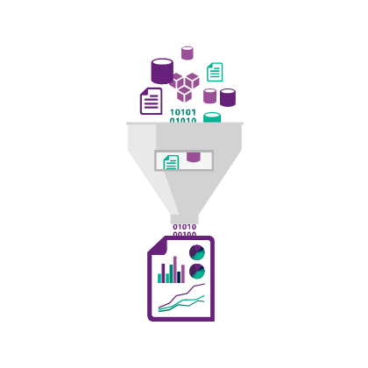
Locating and Inspecting data
Keys to quality source data
Authority
Spread
Consistency
Types and Units
Representation
Notes:
1. In reference to machine learning, but applicable to all data usage: https://azure.microsoft.com/en-us/documentation/articles/machine-learning-data-science-prepare-data/

Slide 29
Azure Data Catalog
Register data sources
Tag the data
Document the data
Search and connect
Notes:
Full example: https://azure.microsoft.com/en-us/documentation/articles/data-catalog-get-started/

Slide 30
Lab:
Adding and searching data on the Azure Data Catalog
Notes:
Open this dataset: https://github.com/Azure/itanomalyinsights-cortana-intelligence-preconfigured-solution/blob/master/Samples/Data-Generator/ADGeneratorData/addemo_input_v1.csv
Note these headings:
"Time" : DATETIME (required) "The timestamp of the event in UTC or UNIX timestamp format (Seconds since Epoch)",
"Value" : FLOAT (required) "The metric value of the event",
"Metric" : VARCHAR(500) (required) "The unique identifier of a particular time series",
"Host" : VARCHAR(100) (required) "The name of the host where the event is fired",
"Region" : VARCHAR(100) (optional) "The region where the event occurs; can be empty",
"Scenario" : VARCHAR(100) (optional) "The scenario to which the event belongs to, can be empty,
"Category" : VARCHAR(100) (optional) "The category associated with the event; can be empty",
"Application" : VARCHAR(500) (optional) "Originating application of the event; can be empty“
3. Open this report reference: https://gallery.cortanaintelligence.com/Solution/Anomaly-Detection-in-Real-time-Data-Streams
4. Follow the instructions from the teacher

Slide 31
Data Ingestion
Notes:
Example of a 3rd Party Solution: https://www.veeam.com/fastscp-azure-vm.html

Slide 32

Azure Event Hubs
Notes:
Overview - https://docs.microsoft.com/en-us/azure/event-hubs/event-hubs-what-is-event-hubs
Authentication and Security - https://docs.microsoft.com/en-us/azure/event-hubs/event-hubs-authentication-and-security-model-overview
Full programming guide - https://docs.microsoft.com/en-us/azure/event-hubs/event-hubs-programming-guide

Slide 33
Options for data ingestion
PowerShell
Azure Data Factory
Azure Event Hubs
Azure storage SDKs (.NET, Node.js, python, C++, etc.)
AzCopy (blob, file, and table only)
Import/Export service
Notes:
PowerShell in Azure Storage - https://azure.microsoft.com/en-us/documentation/articles/storage-powershell-guide-full/
Azure Data Factory data movement - https://azure.microsoft.com/en-us/documentation/articles/data-factory-data-movement-activities/
Azure Automation - https://azure.microsoft.com/en-us/documentation/articles/automation-intro/
Azure storage SDKs – for examples see https://azure.microsoft.com/en-us/documentation/articles/storage-dotnet-how-to-use-blobs/
Azure tools and SDKs in general can be downloaded here - https://azure.microsoft.com/en-us/downloads/
MS Azure Storage Explorer - http://storageexplorer.com/
AzCopy - https://azure.microsoft.com/en-us/documentation/articles/storage-use-azcopy/
Import/Export service - https://azure.microsoft.com/en-us/documentation/articles/storage-import-export-service/

Slide 34
Connect on-prem to <anything>
VPN Gateway
Send network traffic from virtual networks to on-prem locations
Send network traffic between virtual networks within Azure
Site-to-site vs. Point-to-site
You can connect multiple on-prem locations to a virtual network (Multi-site)
ExpressRoute can directly connect your WAN to Azure
Tool-Specific
Notes:
VPN Information: https://azure.microsoft.com/en-us/documentation/articles/vpn-gateway-about-vpngateways/
Connecting to VPN’s: https://azure.microsoft.com/en-us/documentation/articles/vpn-gateway-vpn-faq/#connecting-to-virtual-networks
Using ExpressRoute: https://azure.microsoft.com/en-us/documentation/articles/expressroute-faqs/

Slide 35
Data Exploration
Notes:
Understanding the statistics of exploring data: http://danshuster.com/apstat/apstat_chap01.pdf

Slide 36
Exploring Data
Microsoft R
Azure ML
Excel
Other Tools
Notes:
Data Exploration and Predictive Modeling with R - https://msdn.microsoft.com/en-us/library/mt590947.aspx
Data Exploration with Azure ML - https://blogs.technet.microsoft.com/machinelearning/2015/09/24/data-exploration-with-azure-ml/
Statistics Using Excel – http://www.excelfunctions.net/Excel-Statistical-Functions.html
Sed, awk, grep (in Windows as well) - https://www.simple-talk.com/cloud/data-science/data-science-laboratory-system---testing-the-text-tools-and-sample-data/
Data Science Blog: https://buckwoody.wordpress.com/

Slide 37
Update the Azure Data Catalog
Search
Add Tags
Add Experts
Thoroughly document the data
Notes:
Full example: https://azure.microsoft.com/en-us/documentation/articles/data-catalog-get-started/

Slide 38

Azure Data Factory
Create, orchestrate, and manage data movement and enrichment through the cloud
Notes:
Learning Path: https://azure.microsoft.com/en-us/documentation/articles/data-factory-introduction/
Developer Reference: https://msdn.microsoft.com/en-us/library/azure/dn834987.aspx

Slide 39
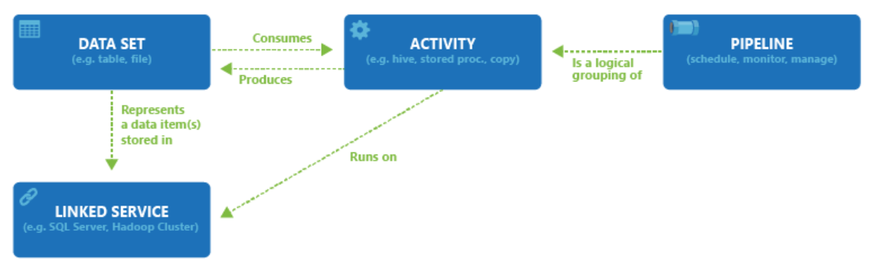
ADF Components
Notes:
Pricing: https://azure.microsoft.com/en-us/pricing/details/data-factory/

Slide 40
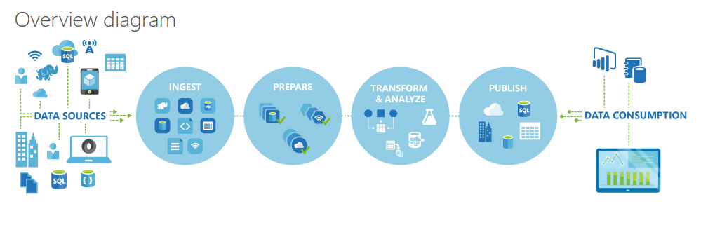
ADF Logical Flow
Notes:
Learning Path: https://azure.microsoft.com/en-us/documentation/articles/data-factory-introduction/
Quick Example: http://azure.microsoft.com/blog/2015/04/24/azure-data-factory-update-simplified-sample-deployment/

Slide 41
ADF Process
Define Architecture: Set up objectives and flow
Create the Data Factory: Portal, PowerShell, VS
Create Linked Services: Connections to Data and Services
Create Datasets: Input and Output
Create Pipeline: Define Activities
Monitor and Manage: Portal or PowerShell, Alerts and Metrics
Notes:
Full Tutorial: https://azure.microsoft.com/en-us/documentation/articles/data-factory-build-your-first-pipeline/

Slide 42
Activity Options
Transformation activity | Compute environment
Hive | HDInsight [Hadoop]
Pig | HDInsight [Hadoop]
MapReduce | HDInsight [Hadoop]
Hadoop Streaming | HDInsight [Hadoop]
Machine Learning activities: Batch Execution and Update Resource | Azure VM
Stored Procedure | Azure SQL
Data Lake Analytics U-SQL | Azure Data Lake Analytics
DotNet | HDInsight [Hadoop] or Azure Batch
Notes:
Main Document Site: https://azure.microsoft.com/en-us/documentation/articles/data-factory-data-transformation-activities/

Slide 43
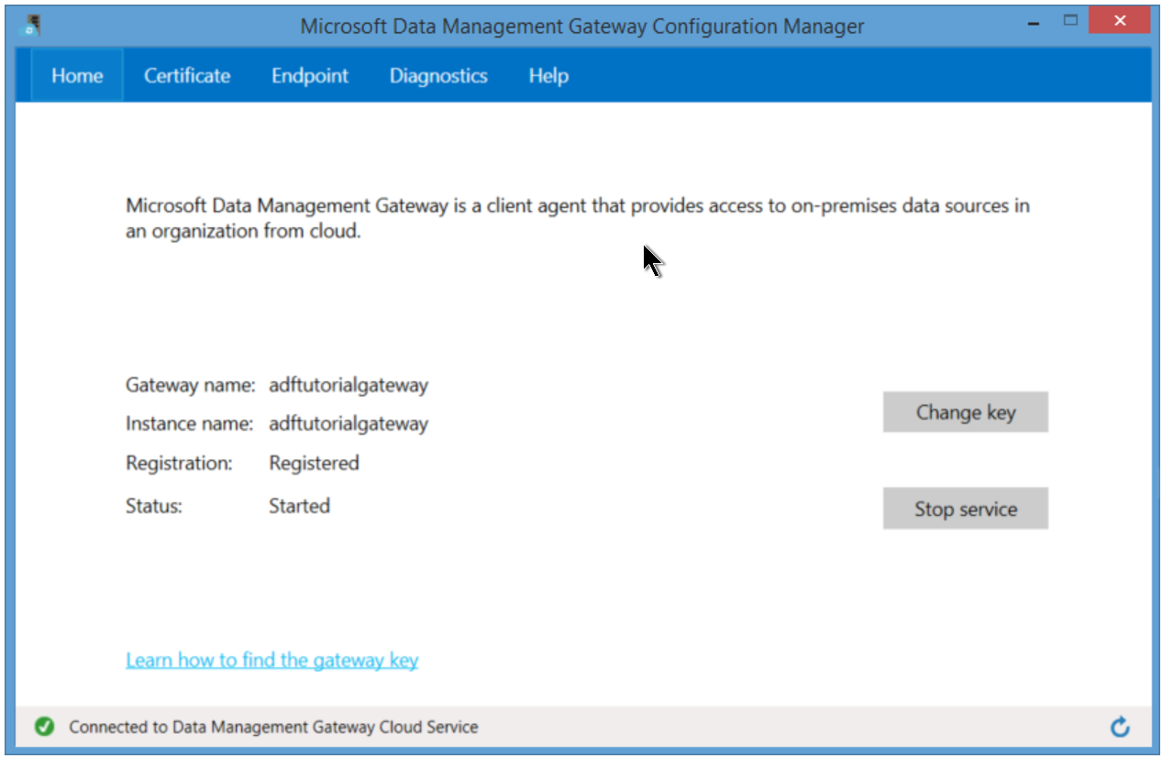
Gateway for On-Prem
Notes:
Activities: https://azure.microsoft.com/en-us/documentation/articles/data-factory-create-pipelines/

Slide 44
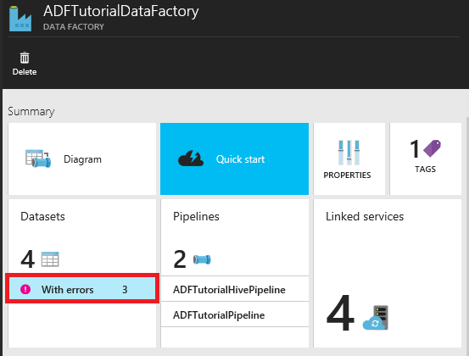
Locating Failures within a Pipeline
Notes:
PowerShell script to help deal with errors in ADF: http://blogs.msdn.com/b/karang/archive/2015/11/13/azure-data-factory-detecting-and-re-running-failed-adf-slices.aspx

Slide 45
Lab:
Create an ADF Project
Notes:
Open this reference and follow all steps you see there: https://docs.microsoft.com/en-us/azure/data-factory/data-factory-copy-activity-tutorial-using-azure-portal

Slide 46
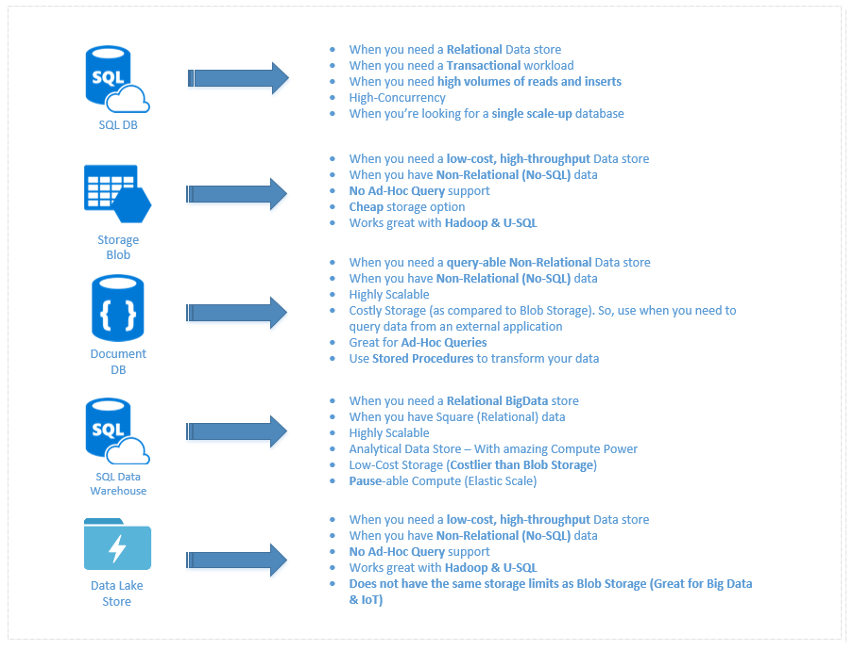
Data Storage Technologies
Notes:
A discussion of this graphic: https://buckwoody.wordpress.com/2016/05/16/the-cortana-intelligence-suite-what-to-use-when/

Slide 47
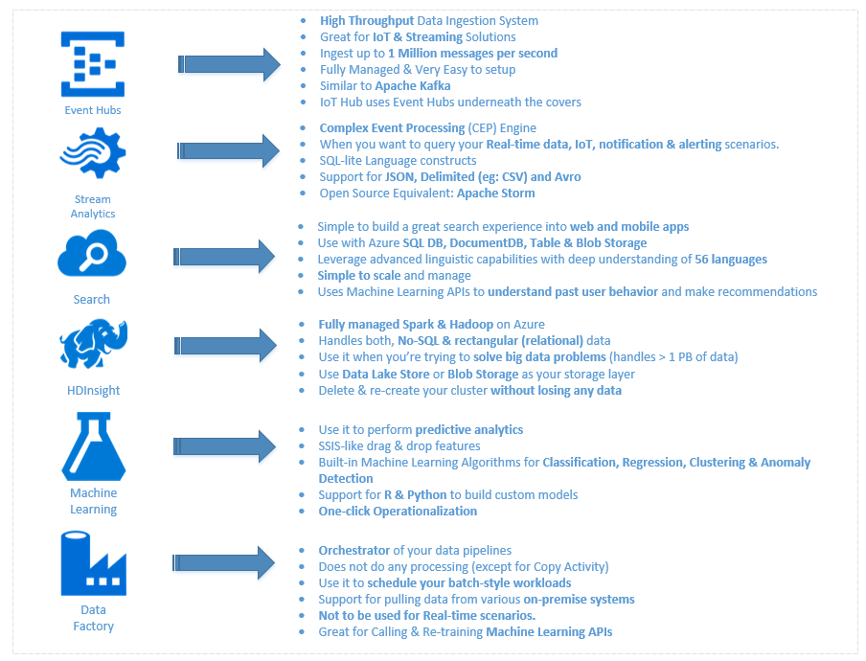
Data Processing Technologies
Notes:
A discussion of this graphic: https://buckwoody.wordpress.com/2016/05/16/the-cortana-intelligence-suite-what-to-use-when/

Slide 48
Analytics Options
You're looking for... | You can use this
A fully managed relational database that provisions quickly, scales on the fly, and includes built-in intelligence and security | Azure SQL Database
A fully managed, elastic data warehouse with security at every level of scale at no extra cost | Azure SQL Data Warehouse
A fully managed cloud Hadoop and Spark service backed by 99.9% SLA for your enterprise | HDInsight
A fully managed cloud service to easily build, deploy, and share predictive analytics solutions | Machine Learning
An on-demand, real-time stream processing service with enterprise-grade security, auditing, and support | Stream Analytics
A no-limits data lake built to support massively parallel analytics | Data Lake Store
A fully managed on-demand pay-per-job analytics service with enterprise-grade security, auditing, and support | Data Lake Analytics
An enterprise-wide metadata catalog that makes data asset discovery simple | Data Catalog
A data integration service to orchestrate and automate data movement and transformation | Data Factory
Notes:
Easily build and deploy anywhere
Use existing skillsets and tools you know and love to build intelligent apps and deploy without a change in code. Build once, deploy anywhere: in the cloud, on premises, and to edge devices, with the confidence of global distribution to more data centers than any other provider.
An open platform
Choose your favorite technologies, including open source. Azure supports a range of deployment options, popular stacks and languages, and a comprehensive set of data engines. Capitalize on this flexibility, plus the performance, scale, and security delivered by Microsoft technologies to build apps for any scenario.
Develop apps with built-in intelligence
Building intelligent apps using Azure is easy, because no other platform brings analytics and native AI to your data wherever it lives and in the languages you use. Take advantage of a rich set of cognitive APIs to easily build new experiences into your apps for human-like intelligence.
SQL Database
Built for developers, SQL Database is a relational database management system with enterprise-class availability, scalability, and security, and built-in intelligence capable of learning app patterns, that can be accessed from anywhere in the world.
SQL Data Warehouse
Scale compute and storage independently with this SQL-based, fully managed, petabyte-scale cloud data warehouse that’s highly elastic and enables you to set up in minutes and scale capacity in seconds.
HDInsight
A fully managed cloud Hadoop and Spark service, HDInsight provides open source analytic clusters for Spark, Hive, MapReduce, HBase, Storm, Kafka, and Microsoft R Server backed by a 99.9% SLA.
Machine Learning
Easily build, deploy, and manage predictive analytics solutions with this fully managed cloud service and deploy your model into production as a web service in minutes that can be called from any device, anywhere.
Data Factory
Compose and manage data services at scale with this globally deployed data movement service in the cloud that connects to on-premises and cloud data sources.
Stream Analytics
Develop and run massively parallel real-time analytics on multiple streams of data with this analytics service that helps uncover real-time insights from devices, sensors, infrastructure, and applications
Data Lake Store
Built to the open HDFS standard, this is a no-limits cloud data lake for your enterprise’s unstructured, semi-structured, and structured data that’s massively scalable and secured, and allows you to run massively parallel analytics.
Data Lake Analytics
Develop and run massively parallel data transformation and processing programs in U-SQL, R, Python, and Microsoft .NET over petabytes of data with this on-demand service that provides a simple, scalable way to analyze big data—in seconds.
Data Catalog
Spend less time looking for data and more time getting value from it with this fully managed cloud service that lets you register, enrich, discover, understand, and consume your enterprise data sources.

Slide 49
Related content
Data Science Blog: https://buckwoody.wordpress.com/
The Team Data Science Process: http://tinyurl.com/ya3n7p9z
Microsoft Business Analytics and AI: http://tinyurl.com/ydfnduu3

Slide 50
Q&A

Slide 51
Thank you for your attention

